Slide 1


Slide 2
Encounters With Jesus - 6
“The Social Outcast”
Mark 5:21-34
Judith Acreman, Thurrock Christian Fellowship
Sunday 8th August 2026

Slide 3
Mark 5:21-34
Mark 5:21-34 NIV
When Jesus had again crossed over by boat to the other side of the lake, a large crowd gathered around him while he was by the lake. ²² Then one of the synagogue leaders, named Jairus, came, and when he saw Jesus, he fell at his feet. ²³ He pleaded earnestly with him, “My little daughter is dying. Please come and put your hands on her so that she will be healed and live.” ²⁴ So Jesus went with him. A large crowd followed and pressed around. ²⁵ And a woman was there who had been subject to bleeding for twelve years. ²⁶ She had suffered a great deal under the care of many doctors and had spent all she had, yet instead of getting better she grew worse...

Slide 4
Mark 5:21-34
²⁷ When she heard about Jesus, she came up behind him in the crowd and touched his cloak, ²⁸ because she thought, “If I just touch his clothes, I will be healed.” ²⁹ Immediately her bleeding stopped and she felt in her body that she was freed from her suffering. ³⁰ At once Jesus realized that power had gone out from him. He turned around in the crowd and asked, “Who touched my clothes?” ³¹ “You see the people crowding against you,” his disciples answered, “and yet you can ask, ‘Who touched me?’ ” ³² But Jesus kept looking around to see who had done it. ³³ Then the woman, knowing what had happened to her, came and fell at his feet and, trembling with fear, told him the whole truth. ³⁴ He said to her, “Daughter, your faith has healed you. Go in peace and be freed from your suffering.”

Slide 5
Leviticus 15:25-27
“ ‘When a woman has a discharge of blood for many days at a time other than her monthly period or has a discharge that continues beyond her period, she will be unclean as long as she has the discharge, just as in the days of her period. ²⁶ Any bed she lies on while her discharge continues will be unclean, as is her bed during her monthly period, and anything she sits on will be unclean, as during her period. ²⁷ Anyone who touches them will be unclean; they must wash their clothes and bathe with water, and they will be unclean till evening.

Slide 6
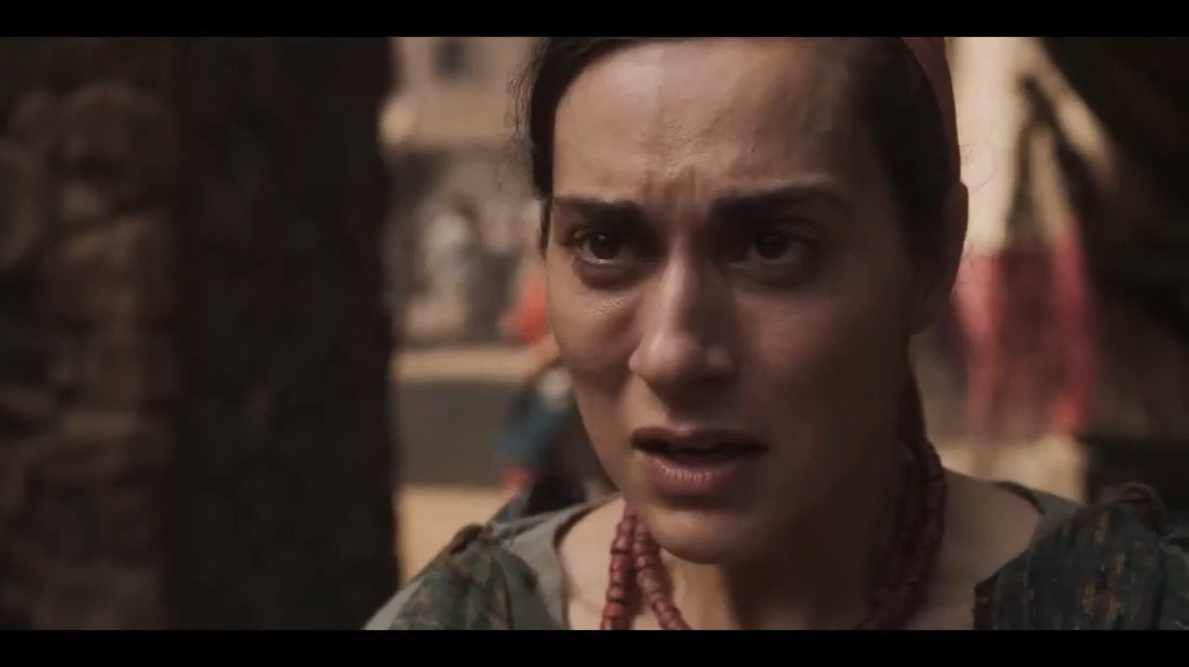

Slide 7
“The Great Day of The Lord”
Malachi 4:1-2 ESV
"For behold, the day is coming, burning like an oven, when all the arrogant and all evildoers will be stubble. The day that is coming shall set them ablaze, says the LORD of hosts, so that it will leave them neither root nor branch. ² But for you who fear my name, the sun of righteousness shall rise with healing in its wings. You shall go out leaping like calves from the stall.

Slide 8
Mark 6:56
And wherever he came, in villages, cities, or countryside, they laid the sick in the marketplaces and implored him that they might touch even the fringe of his garment. And as many as touched it were made well.

Slide 9
Matthew 25:31-40
“When the Son of Man comes in his glory, and all the angels with him, he will sit on his glorious throne. ³² All the nations will be gathered before him, and he will separate the people one from another as a shepherd separates the sheep from the goats. ³³ He will put the sheep on his right and the goats on his left. ³⁴ “Then the King will say to those on his right, ‘Come, you who are blessed by my Father; take your inheritance, the kingdom prepared for you since the creation of the world. ³⁵ For I was hungry and you gave me something to eat, I was thirsty and you gave me something to drink, I was a stranger and you invited me in, ³⁶ I needed clothes and you clothed me, I was sick and you looked after me, I was in prison and you came to visit me.’ ³⁷ “Then the righteous will answer him, ‘Lord, when did we see you hungry and feed you, or thirsty and give you something to drink? ³⁸ When did we see you a stranger and invite you in, or needing clothes and clothe you? ³⁹ When did we see you sick or in prison and go to visit you?’ ⁴⁰ “The King will reply, ‘Truly I tell you, whatever you did for one of the least of these brothers and sisters of mine, you did for me.’

